Slide 1
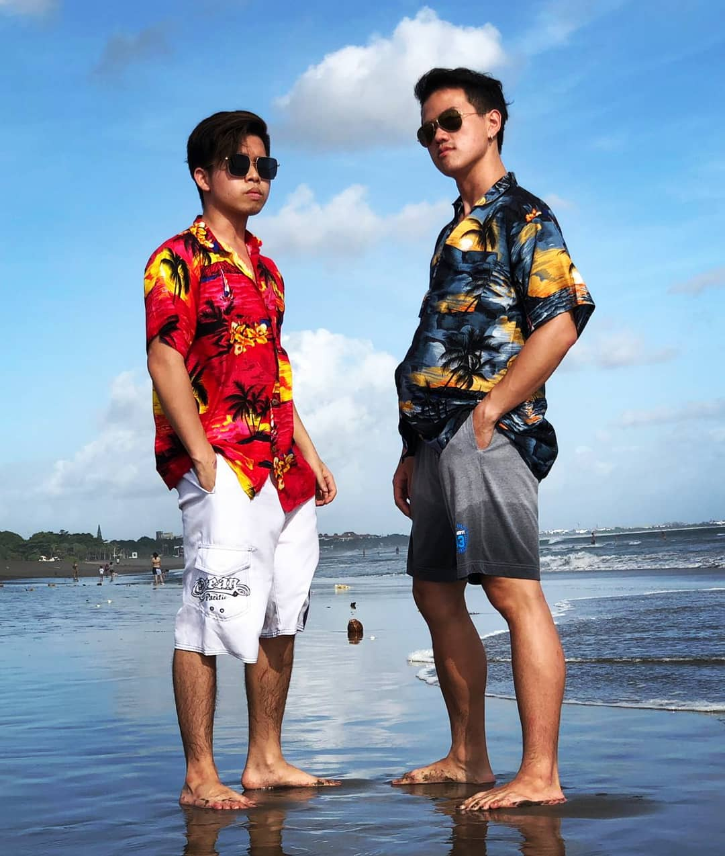
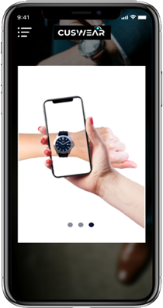
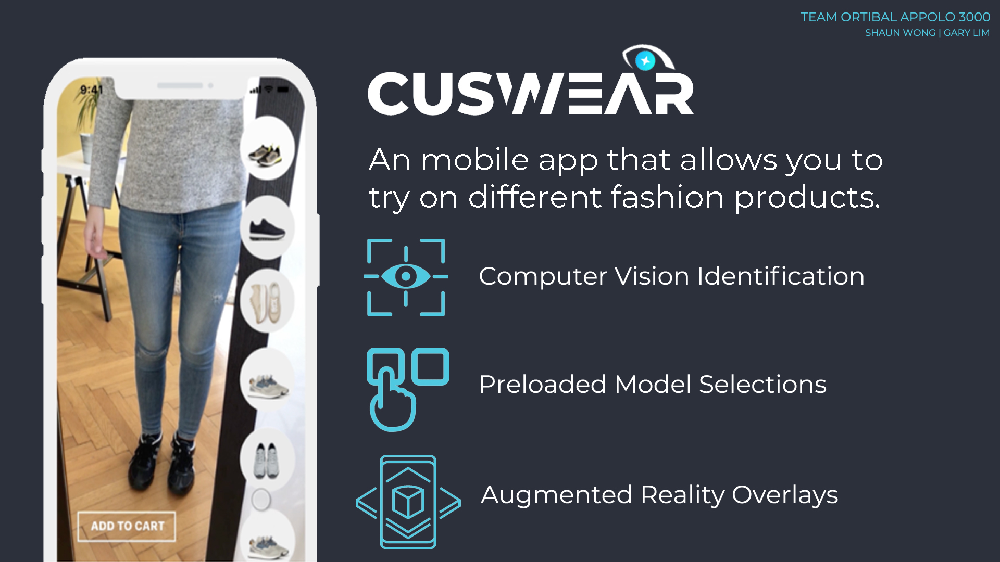
“A mobile app that allows you to try on different fashion products.”
SHAUN WONG | GARY LIM
TEAM ORTIBAL APPOLO 3000
Notes:
Hello! my name is Shaun and My name is Gary and we are ORTIBAL APPOLO 3000.
The project we are working on is cuswear.
We are trying to create a cuswear experience – which is a mobile app that allows one to try on different fashion products, anywhere, anytime.

Slide 2
PROBLEM STATEMENT
The e-commerce industry is saturated, fast-moving and competitive
Shoppers are unable to confidently evaluate and envision the sense of using a product purchased online
Purchases in the fashion industry rely heavily on aesthetics and appearance for sales
Our project focuses on creating a functioning mobile application that is able to overlay 3D models of fashion items in augmented reality.
Notes:
The problem we are trying to tackle lies within the e-commerce industry, where it is saturated, fast-moving and competitive.
A problem that an avid online shopper always has is that they are unable to confidently evaluate and envision the sense of using the product purchased online.
And yet purchases in apparels rely heavily on aesthetics and appearance.
And therefore our project focuses on creating a functioning mobile application that is able to overlay 3D models of apparels using augmented reality technology which we believe will plug the problem at its roots.

Slide 3


CORE FEATURES
Scan and overlay a 3D watch model in augmented reality
Choose between different brands and categories of watches
EXTENSION FEATURES
Bookmark favourite watches
Take a photo or video of how it looks as it appears
View the 3D models of watches in-app
Notes:
For orbital, we will be focusing on watches only—as our minimum viable product. This also works as a proof of concept for other apparel items.
The core features of our application includes being able to scan and overlay a 3D watch model using AR technology
And users will also be able to choose between different brands and categories of watches.
WE have also included a number of possible extensions to improve the cuswear experience such as.
One. a favourites list where users will be able to bookmark and keep track of their favourite watches.
Two, Users will be able to take a photo or video of how the watch looks on their wrist as it appears on our product.
And they will also be able to view the 3D models of watches separately in our application if they wish to.

Slide 4




TECH STACK
Notes:
To achieve our target, we have identified four main tools that we will be using.
Firstly, we will be developing the app for android systems and thus will be coding mainly in Java on android studio.
Secondly, we will be integrating our mobile application with Firebase as it provides a straightforward and easy-to-use avenue for us to store our beautiful 3D models of watches and other user data.
Last but not least, we will be using Unity together with Vuforia. We chose these platforms because Unity integrates the Vuforia engine which provides many functions for developers to create augmented reality experiences.
As first-time developers, our background in programming comprises mainly only of completing CS2030. Therefore, we have spent much of our June holidays and the “Ideation stage” simply learning how to use these tools. But fear not, for we have come up with a visual mock-up of what our mobile app would look like.

Slide 5
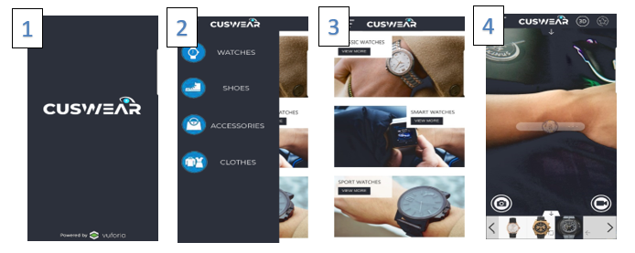
MOCK-UP
Notes:
In this slide you will see a visual mock-up of our mobile app, with the different numbers illustrating the user flow.
In photo 1, the user opens the app and is greeted with the CUSWEAR logo.
The user can then go on to select different categories of clothing they would like to try on, such as watches, shoes, accessories etc., as seen in photo 2. It is worth mentioning however that we will only be implementing watches during this orbital project with the other categories as proof of concept for future development.
After choosing a category, the user is brought to photo 3, in which he can select the different brands of watches he would like to view.
And finally, after selecting a watch, the user would have to place a tracker on his hand and scan it before being able to see the 3D model overlaying his hand. Ta da!

Slide 6
THANK YOU!
Notes:
That’s all for our project. More information can be found in our project README and Log. We thank you so much for listening. Bye bye!

